Slide 1
Nakuja Internship 2026
Solid Propulsion Team
Weekly report #10
Presented by: Collins Kinyua
August 21, 2026

Slide 2
This week's tasks
Cooking of grains for 4 grain test (stainless steel) & 5 grain test (Aluminium)
Machining of core rods
3 grain static test
Liner preparation
One grain static test

Slide 3
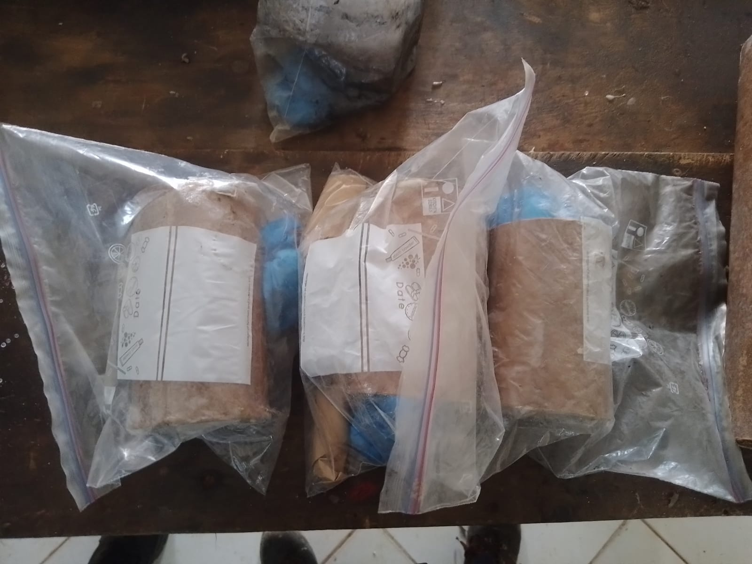
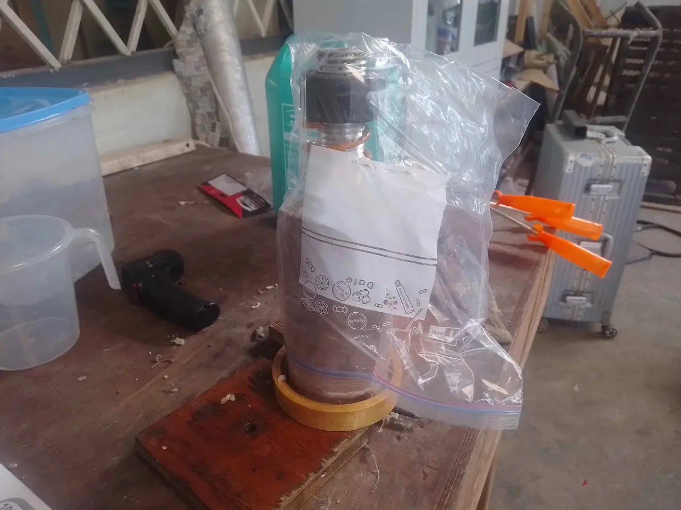
Cooking of grains for 5 grain test
Purpose: These grains will be used during the 5 grain static test which will be held on Wednesday 26/08/2026.
Result: 5 out of 9 grains have been prepared

Slide 4
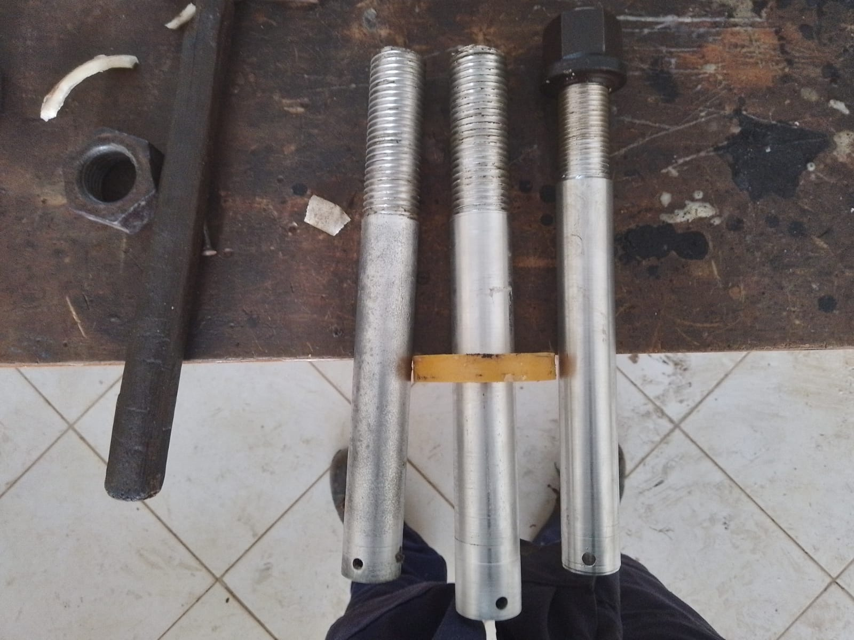
2. Machining of core rods
Purpose: In preparation for mass production, the machining sub-team has been machining 3 new core rods to help increase number of grains cooked per day
Result: 3 out of 4 core rods complete

Slide 5
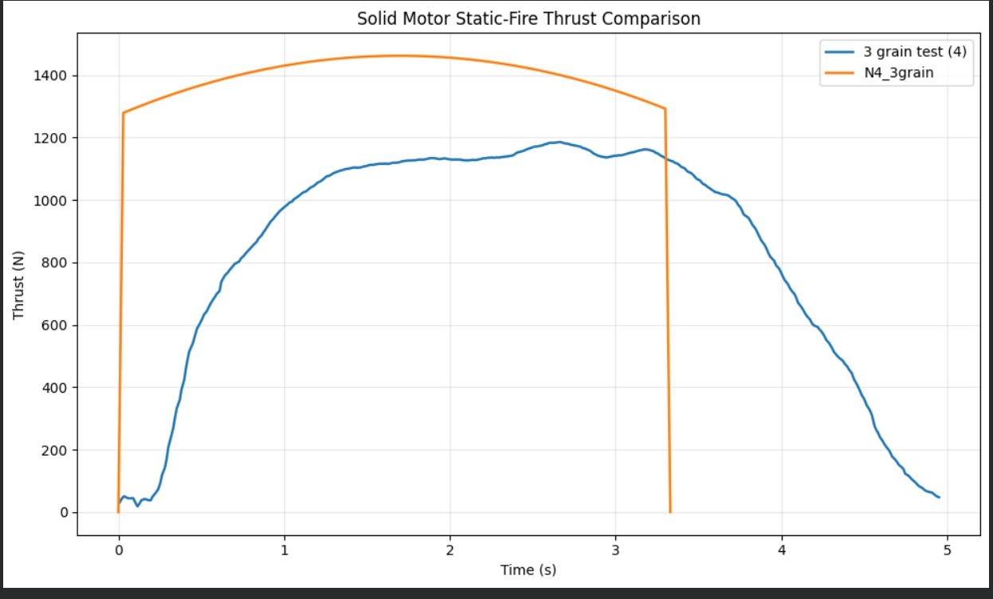

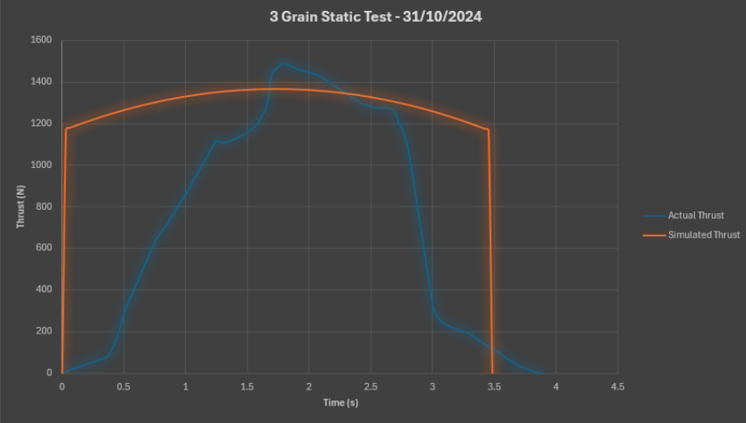
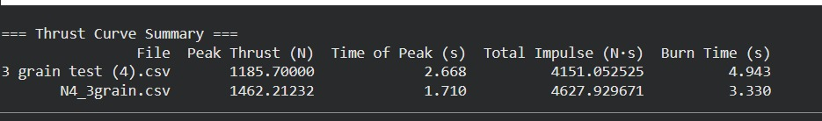
3. 3 grain static test
Purpose: This test was done in order to quantitatively verify the effect of adding 1% of Sodium Bicarbonate to the KNSB grains to act as a suppressant thus effectively lowering the peak thrust and by extension peak pressure values.
Result: The static test was a success with the data indicating lower thrust values than simulated one. The motor produced an ISP which was 89.69% of the theoretical maximum.
Results from previous test

Slide 6
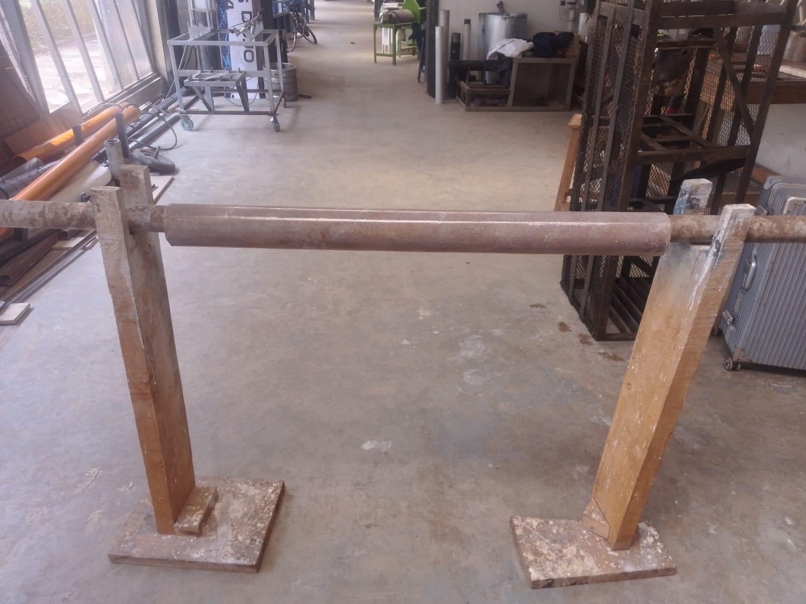
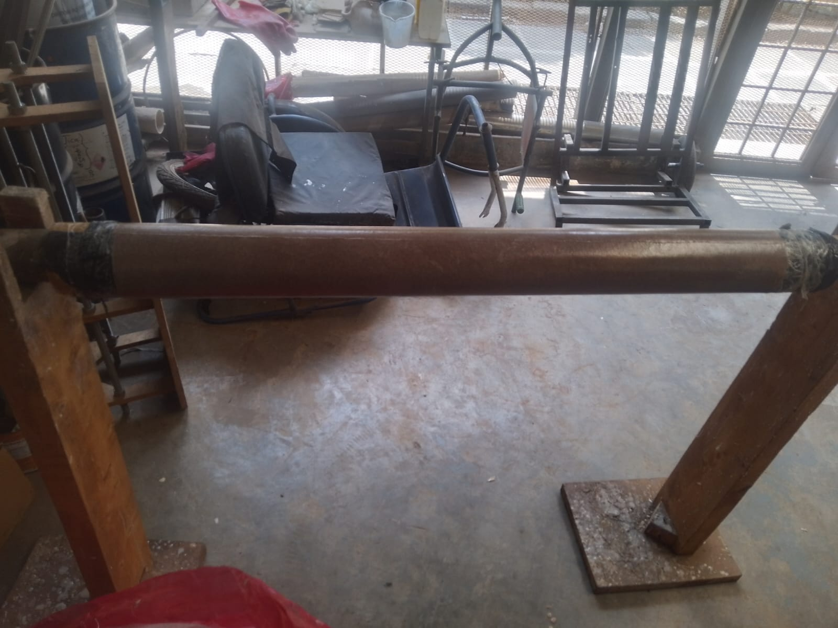
4. Liner preparation
Purpose: In preparation of the static tests campaign, we have fabricated 2 liners and both can fit the Aluminium and Stainless Steel fabrication.
Result: 5 out of 6 liners have been fabricated

Slide 7
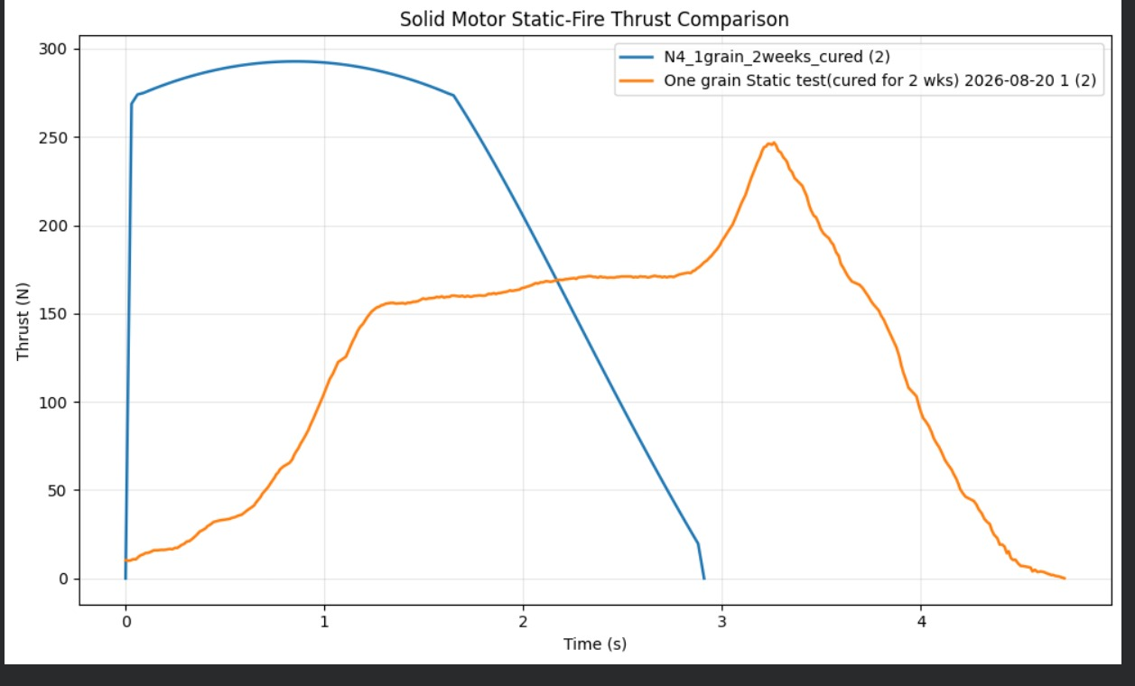
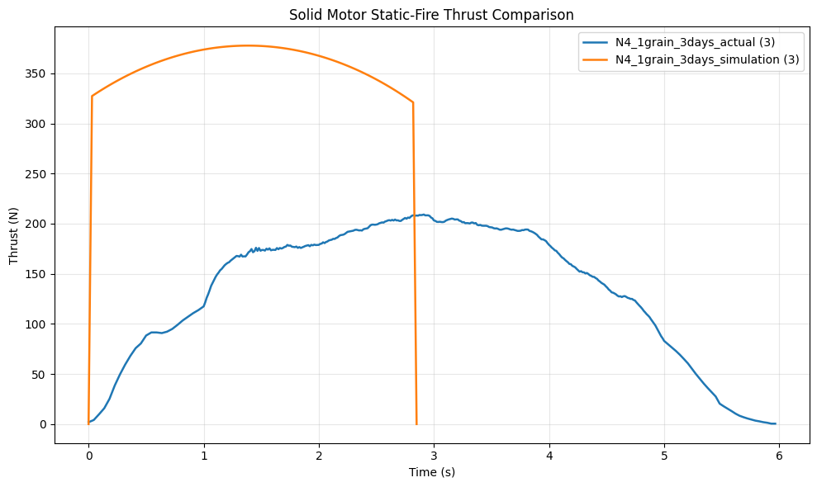
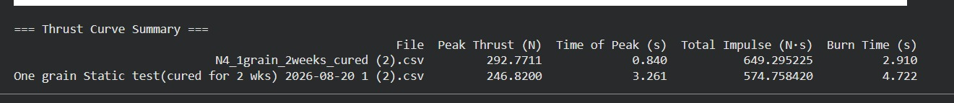
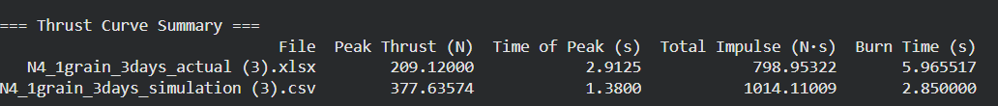
5. One grain static test: Cured after 2 weeks vs 3 days
Purpose: This static test was done in order to make a quantitative decision on the curing time for KNSB propellant grain. According to Richard Nakka, he states that for KNSB grains need one or two days prior to demoulding i.e removing the core rod (we remove the core rod after a day) after which the grains have fully cured and solidified. He also states that full curing may take a week but is is perfectly acceptable to fire a grain anytime after demoulding. https://www.nakka-rocketry.net/sorb.html
As observed from the first static test i.e. grain cured after 2 weeks, the longer the grain stays in storage, the higher the chances of being exposed to moisture which lowers the quality of the grain.
Conclusion: Curing time shall be 5 days instead of 3 to allow the grain to solidify properly
Results from 2 weeks cured Results from 3 days cured

Slide 8
Next week’s tasks
5 grain static test
Motor assembly for 4 grain stainless steel casing
Cooking of grains
Liner preparation
Nozzle and bulkhead fabrication

Slide 9
Challenges experienced
Transport of the test stand using a wheelbarrow has become tedious and is creating internal friction.
Supervisors’ note:
Visit Solid Propulsion github projects @ https://github.com/orgs/nakujaproject/projects/26 to review the tasks done.

Slide 10
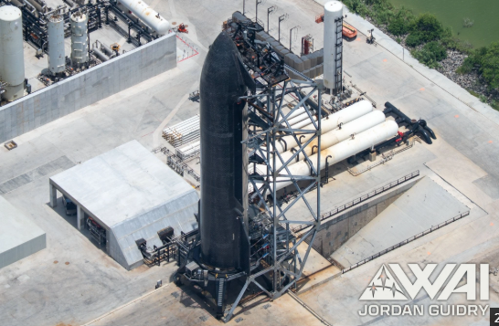
Thank you for your attention!

